Slide 1
Walmart Cost of Equity Capital
Financial Analysis

Slide 2
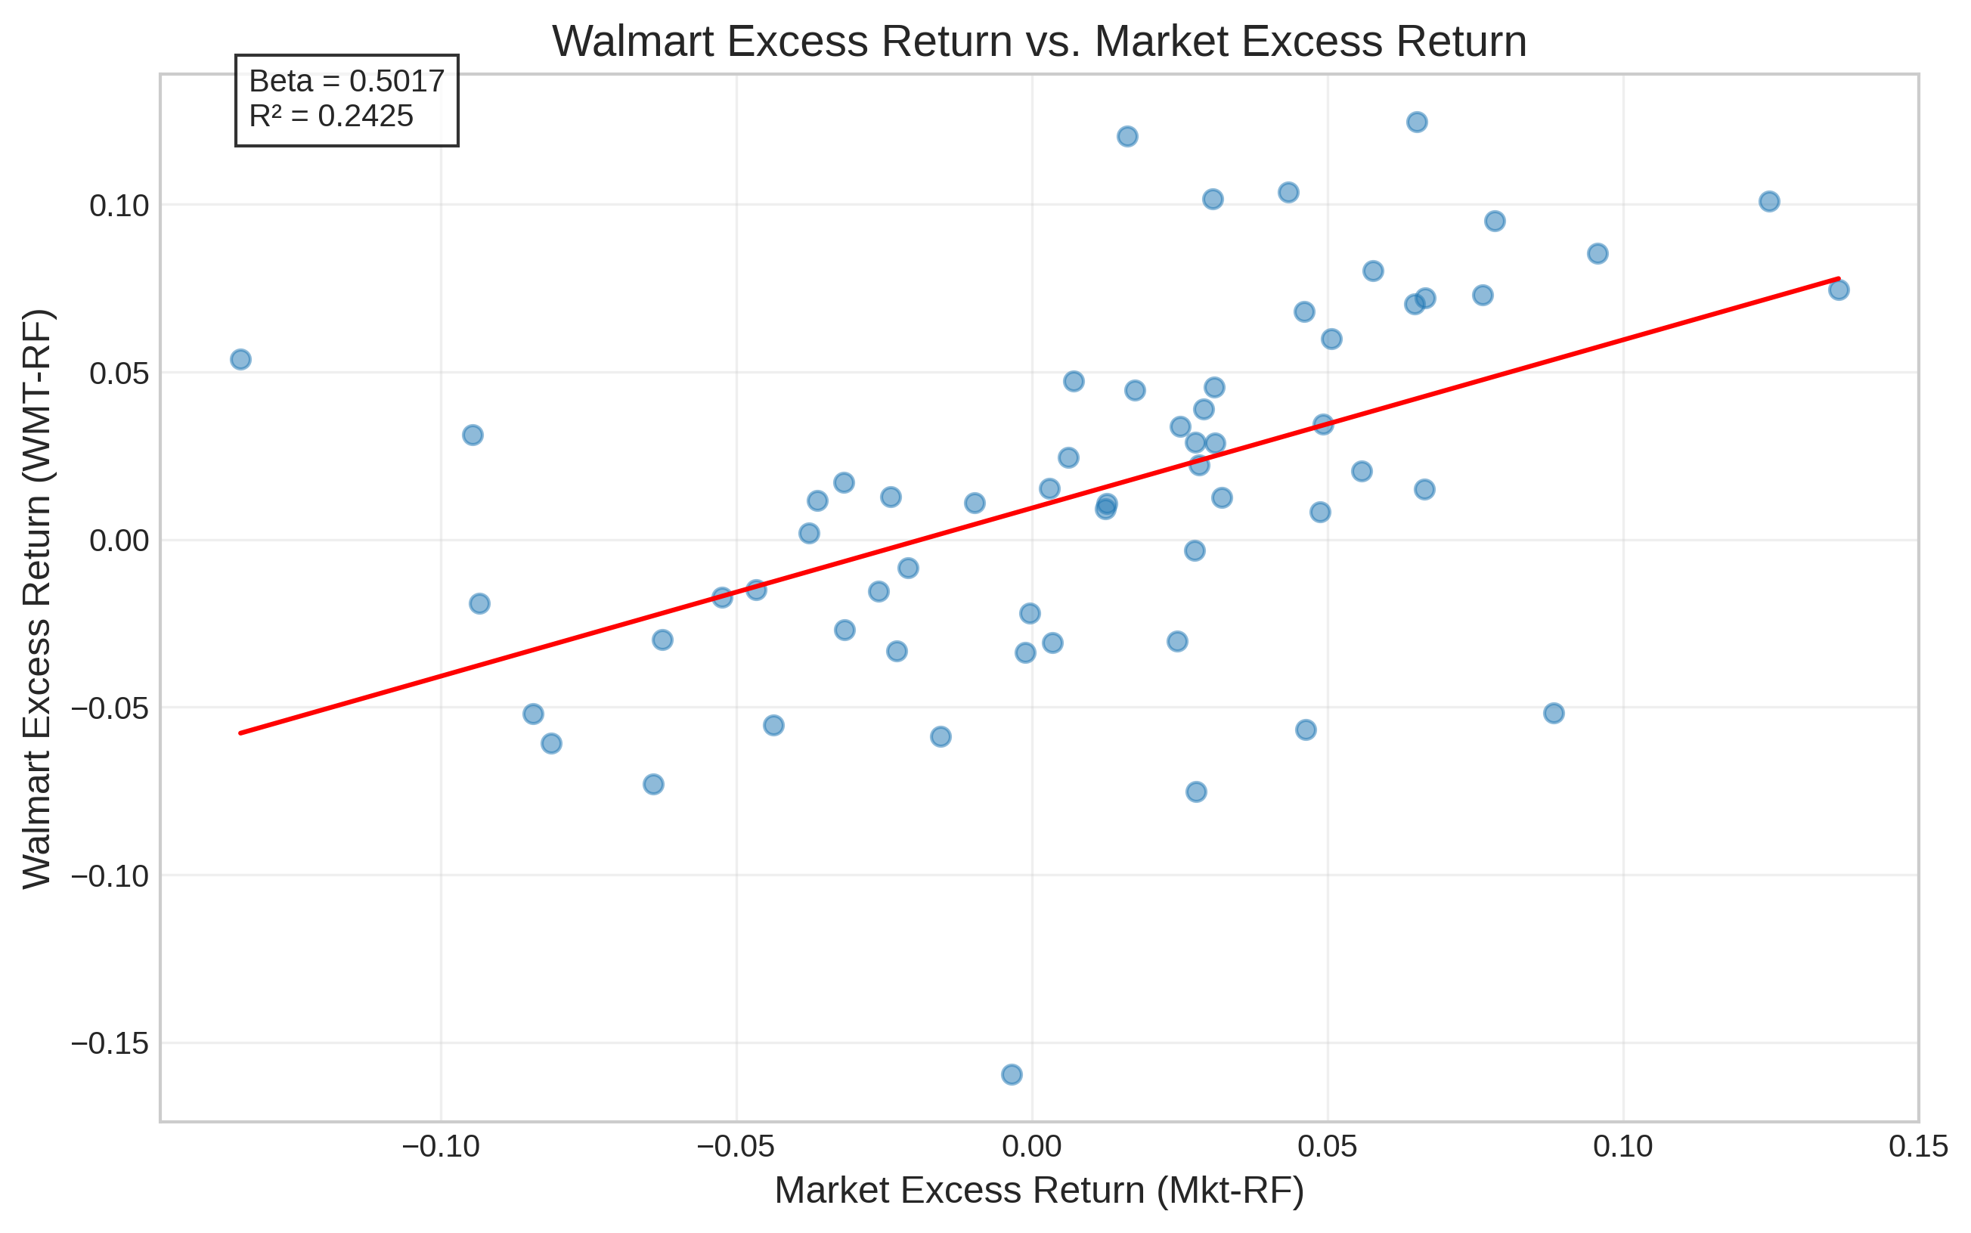
Walmart Excess Return vs. Market Excess Return

Slide 3
Cost of Equity Capital Calculation
Component | Value | Description
Risk-Free Rate | 0.0422 (4.22%) | Current 3-month T-bill rate
Beta | 0.5017 | Regression coefficient of WMT-RF on Mkt-RF
Market Risk Premium | 0.0851 (8.51%) | Annualized historical mean of Mkt-RF since 1927
Cost of Equity | 0.0849 (8.49%) | Risk-Free Rate + Beta × Market Risk Premium

